Slide 1

INSY6212w
INSY6212w
Assignment 2
LU1 to LU6

Slide 2
1.1. LU4: Chapter 4
Establish Project Objective
Planning process is based on the project objective
  Establishes what is to be achieved
  Often stated in the project charter or RFP
  Is the tangible end product
Project objective includes
  Expected benefits
  Primary project end product or deliverable
  Date required to be completed
  Budget
Changes agreed upon by customer and contractor
Examples of Project Objectives on page 108
Notes:
Establish project objective
The planning process is based on the project objective.
The project objective establishes what is to be achieved.
Often the project objective is stated in the project charter or RFP.
It is the tangible end product that the project team or contractor must produce and deliver in order for the sponsor or customer to achieve the expected benefits from implementing the project.
The project objective should include the following elements:
Expected benefits that will result from implementation of the project and define success
Primary project end product or deliverable
Date by which the project is required to be completed
Budget within which the project must be completed
Situations can arise where the project objective needs to be modified as the project proceeds because of extenuating circumstances or new information. The project manager and the customer must agree on all changes to the project objective. Any such changes might affect the remaining work scope, deliverables, completion date, and final cost.

Slide 3
1.2. LU4: Chapter 4
Define Project Scope
Project scope
Project scope document
Defines what needs to be done
Includes
  Items contained in project charter, RFP, proposal
  More detail
Establishes common understanding of scope with stakeholders
Usually contains
  Customer requirements
  Statement of Work (SOW)
  Deliverables
  Acceptance criteria
  Work Breakdown Structure (WBS)
Establishes baseline
Change control system to avoid scope creep
Notes:
Define project scope
The project scope defines what needs to be done.
A project scope document includes many of the items contained in the project charter, RFP, or contractor’s proposal, but in much greater detail. The document is valuable for establishing a common understanding among project stakeholders regarding the scope of the project.
The project scope document usually contains the following sections:
Customer requirements define the functional or performance specifications for the project’s end product and other project deliverables.
It should also include or reference applicable technical specifications, standards, and codes that must be used and met regarding quality and performance of the project work and deliverables.
Statement of Work (SOW) defines the major tasks that will need to be performed to achieve the work that needs to be done and produce all the project deliverables.
Deliverables are the products or outputs that the project team or contractor will produce and provide to the customer during and at the completion of the performance of the project.
Acceptance criteria for all project deliverables must be described in greater detail than what is stated in the project charter or request for proposal
Work Breakdown Structure (WBS) is a hierarchical decomposition of the project work scope into work packages that produce the project deliverables.
The agreed-upon project scope document establishes the baseline for any changes that may be made to the scope during the performance of the project.
A change control system needs to be established to define how changes will be documented, approved, and communicated. The project team or contractor must avoid scope creep, which is informally making changes to the project scope without appropriate approval.

Slide 4
1.3. LU4: Chapter 4
Plan for Quality
Complete work according to specifications and standards
Plan for assuring quality as project progresses
Include
  References for specifications and standards
  Written procedures for quality tools and techniques
Key aspects
  Monitor as the project progresses
  Do work right the first time rather than rework
Notes:
Plan for quality
Planning for quality is a necessary, yet often forgotten or dismissed, function on a project. It is essential to have a plan for assuring the quality of project deliverables and results, rather than waiting until the end of the project to check if the sponsor/customer requirements and expectations on project deliverables have been met.
It is important to plan for quality in performing the project. This helps assure that the work is done according to specifications and applicable standards and that deliverables meet acceptance criteria.
A project quality plan includes or references:
Project specifications and standards
Industry or government standards (for design, testing, safety, construction, etc.)
Codes that must be used and met during the performance of the project work
Written procedures for using various quality tools and techniques
The key to quality control is to:
Monitor the quality of the work early and regularly throughout the performance of the project
Compare results with quality standards
Make any necessary corrective actions immediately, rather than waiting until all the work is completed before checking or inspecting for quality
To ensure that a project is done right the first time, a project should focus on doing the work in accordance with quality standards, and therefore preventing quality problems.

Slide 5
1.4. LU4: Chapter 4
Create Work Breakdown Structure
Deliverable-oriented hierarchical decomposition
Organise project work and deliverables
Create logical groupings
Subdivide into more manageable components
  Deliverable is output of work package
  Resource requirements and durations can be assigned
  Accountability can be assigned
  Project manager can monitor and control
Graphic chart or indentured list
Notes:
Create work breakdown structure
Once the project scope document has been agreed on and prepared, the next step in the planning phase is to create a detailed work breakdown structure (WBS).
This is a deliverable-oriented hierarchical decomposition of the project work scope into work packages, or activity groupings, that produce the project deliverables.
Creating a WBS is a structured approach for organising all the project work and deliverables into logical groupings. This helps to subdivide the deliverables into more manageable components called work items, to help ensure that all tasks required to complete the project are identified and included in the baseline project plan.
The WBS should be deconstructed to a level that identifies individual work packages for each specific deliverable listed in the project scope document.
Dividing a project into work packages and work items helps a contractor increase the level of confidence that:
All the activities that need to be performed to produce the deliverable can be defined
The types and quantities of resources can be determined
The associated activity durations and costs can be reasonably estimated.
Work items should be broken down to the level at which a single organisation (marketing communications, materials engineering, human resources, a subcontractor, etc.) or individual can be assigned responsibility and accountability for achieving the work package.
The WBS can be created using a graphic chart format or as a list.

Slide 6
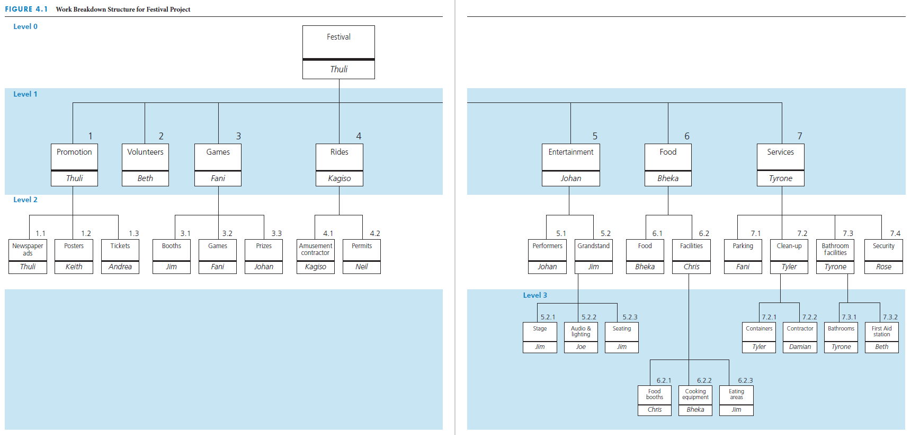
WBS with breakdown to different levels
Notes:
WBS with breakdown to different levels
This figure depicts the work breakdown structure in a graphic chart format for a community festival project.
Note that not all of the branches in a WBS have to be broken down to the same level.

Slide 7
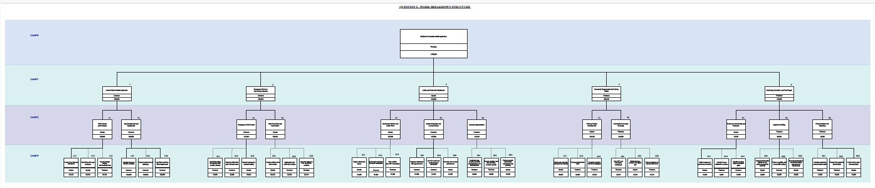
Example of a WBS

Slide 8
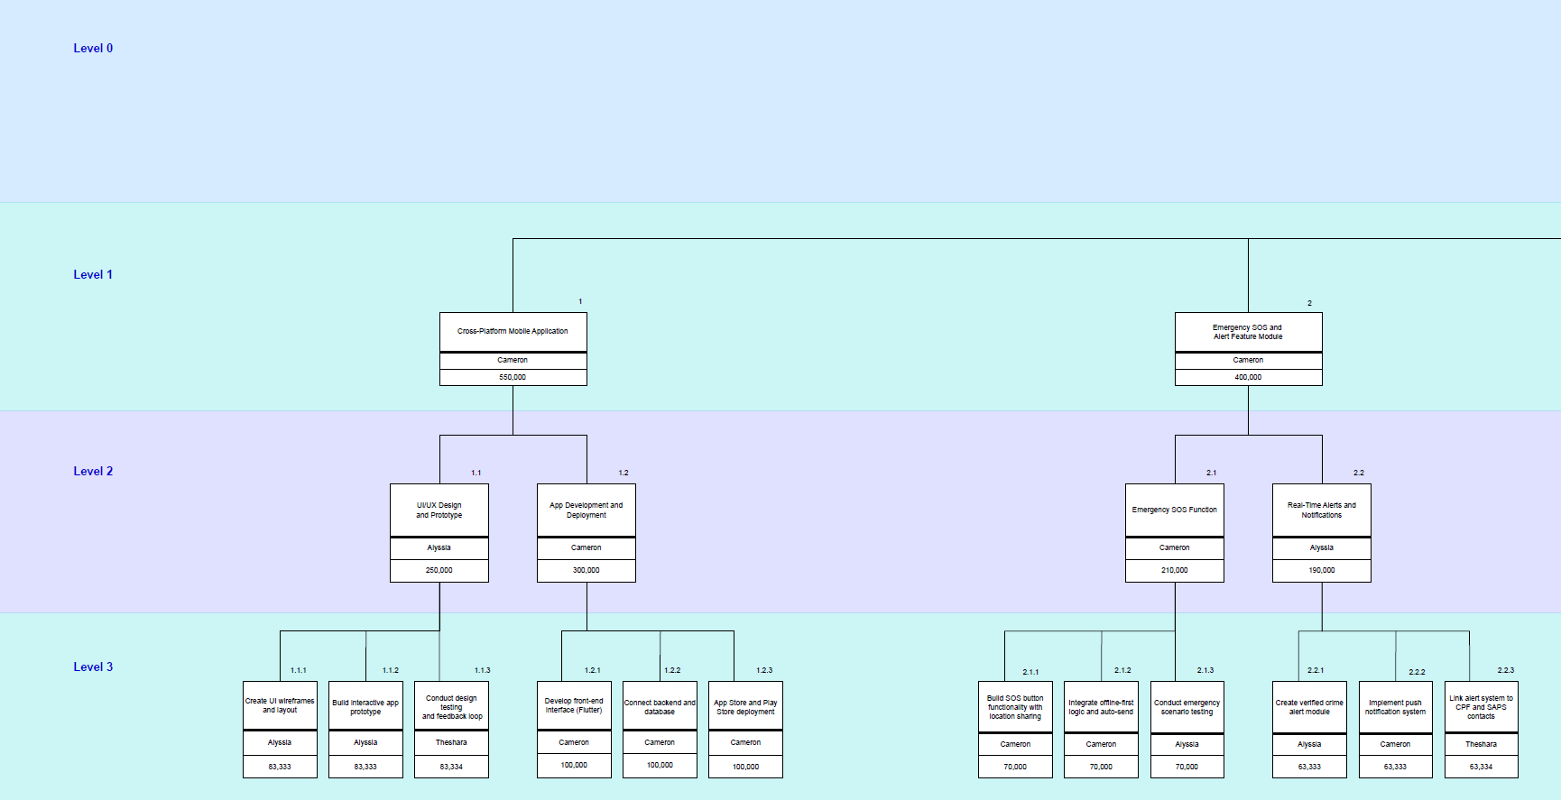

Slide 9
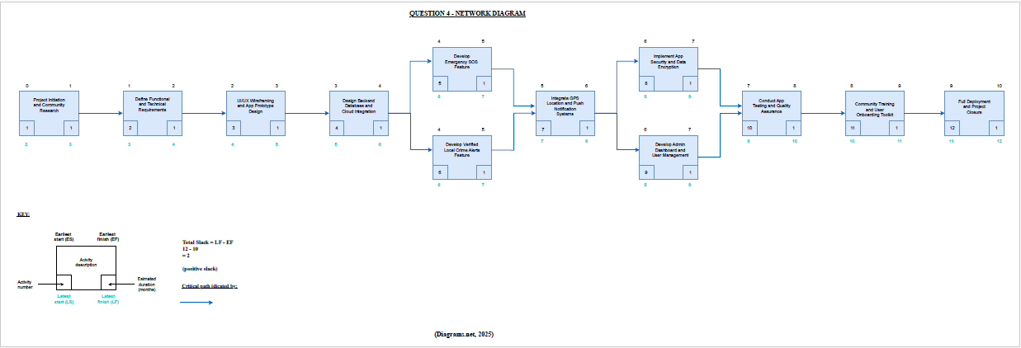
1.5. Network Diagram

Slide 10
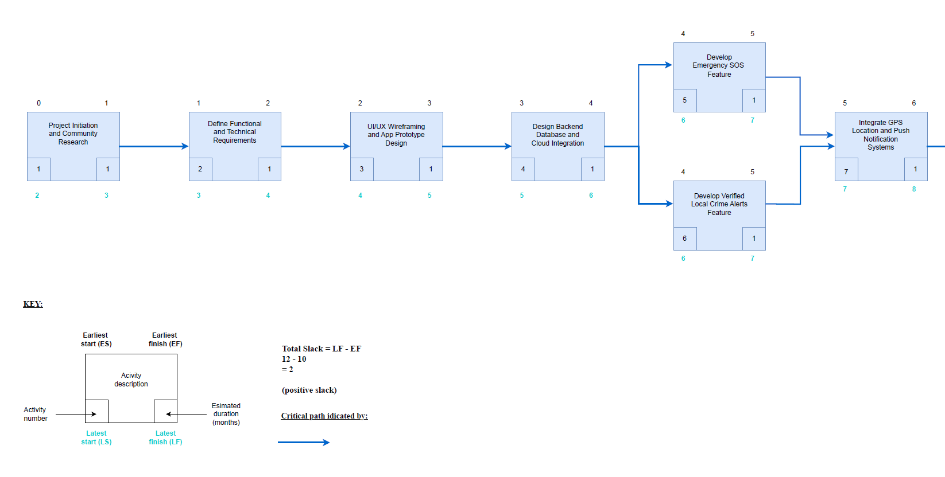

Slide 11
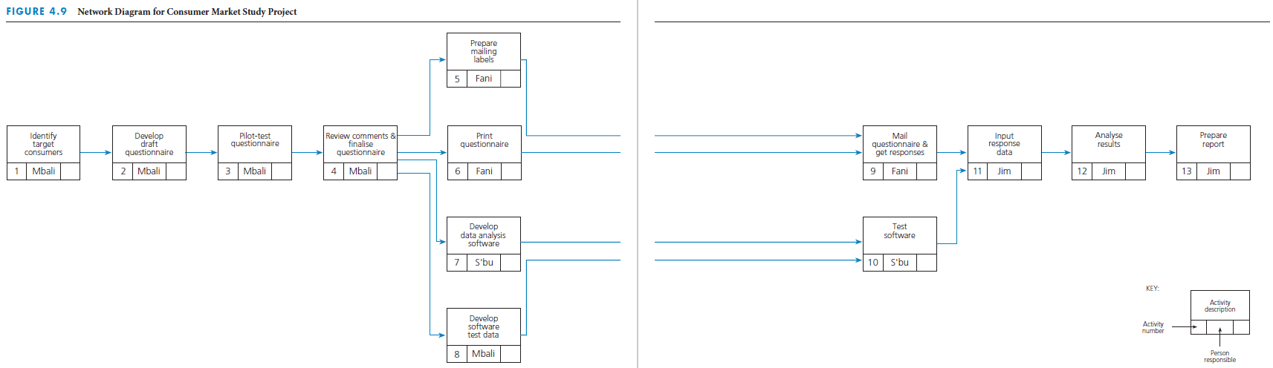
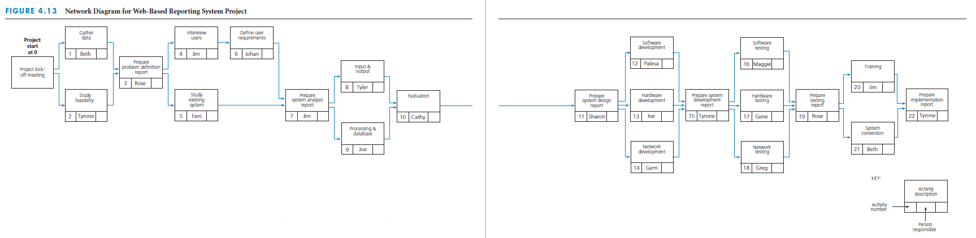
1.5. LU4: Chapter 4 and LU6: Chapter 5
Sequence Activities
Network diagram
  Defines the sequence of activities and relationships
  Tool for arranging order
Common techniques
  PERT
  CPM
  PDM
Notes:
Sequence activities
A network diagram defines the sequence of how the activities will get done. It is a tool for arranging the specific activities in the best sequence and defining their dependent relationships.
The three most common techniques of network diagramming are program evaluation and review technique (PERT), the critical path method (CPM), and the precedence diagramming method (PDM).
In the past, there were distinguishable methodological differences between PERT and CPM. Today, however, when most people refer to a CPM diagram or PERT chart, they mean a generic network diagram.
The top figure shows a complete network diagram for a consumer market study project, with the person responsible for each activity included on the diagram.
The bottom figure shows a network diagram for a web-based reporting system project.

Slide 12


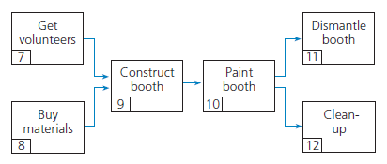
Network principles
Activities
  Represented by a box
  Consume time
  Described by verb
Relationships
  Linked in serial sequence
  Complete concurrently
Notes:
Network principles
Each activity is represented by a box in the network diagram and the description of the activity is written within the box, as shown in this figure.
Activities consume time, and their description usually begins with a verb (such as get, wash, and dry in this example).
Activities have a dependent relationship – that is, they are linked in a logical sequence in a network diagram to show which activities must be finished before others can start.
Certain activities have to be done in serial sequence.
Some activities may be done concurrently.

Slide 13
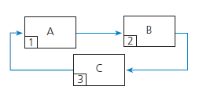
Loops
Illogical relationship among activities
Perpetually repeats itself
Not acceptable
Notes:
Loops
An illogical relationship among activities is known as a loop.
In preparing a network diagram, drawing activities in a loop is not acceptable because it portrays a path of activities that perpetually repeats itself.

Slide 14
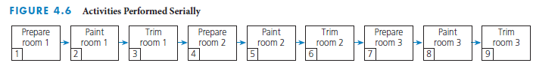
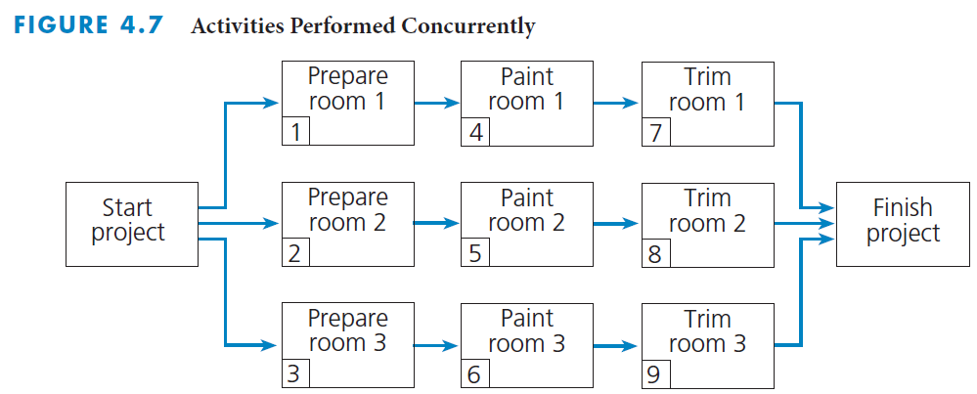
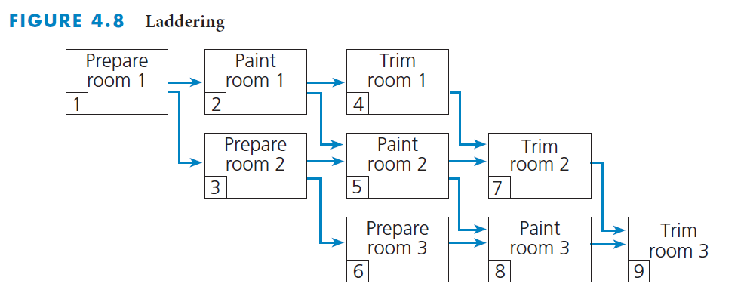
Laddering
Set of repeating activities
Serial sequence
  One work
  Two wait
Can be performed at same time
Would need triple resources
Ladder activities
Allow for shortest possible time for completion
Best use of the three workers and experts
Notes:
Laddering
Some projects have a set of activities that are repeated several times.
The top figure shows a series of activities that must be done in serial sequence, which means that, for an activity with three people, at any one time only one person is working while two other people are waiting.
The middle figure shows a set of activities that can be performed concurrently. However, it is often not practical to perform the activities in this way because the organisation would need triple the experts – one for each room.
The bottom figure shows a technique known as laddering. This approach allows the project to be completed in the shortest possible time, while making the best use of available resources.

Slide 15
Create network diagram
Tips and techniques
Development of diagram
Logical sequence of activities
Show dependent relationships
Elaborate as project progresses
Use subnetworks for similar activity sequences and relationships
Questions to answer
  Finish before next start?
  Done concurrently?
  Cannot be started next?
Guidelines for detail level
  Define each work package
  Draw summary level network then add detail
  Detail to responsibility or deliverable change
  Duration less than project progress review
Notes:
Create network diagram
A network diagram is a drawing of the activities for a project, displayed in boxes in their logical sequence and connected by arrows to indicate dependent relationships. The network diagram shows how the project should be performed from start to completion.
Three questions need to be answered regarding each activity. The network is based upon the answers:
Which activities must be finished immediately before this activity can be started?
Which activities can be done concurrently with this activity?
Which activities cannot be started until immediately after this activity is finished?
Guidelines for the level of detail in the network diagram are:
Based on the work breakdown structure for a project; specific activities should be defined for each work package.
It may be preferable to draw a summary-level network first that depicts a small number of higher level activities and then expand to a more detailed network.
The level of detail may be determined by certain obvious interface or transfer points such as a change in responsibility or if there is a tangible output or product or deliverable as a result of an activity.
Activities should not be longer in estimated duration than the project progress review.
It is not unusual to progressively elaborate the network diagram as the project progresses and more information becomes clear.
Subnetworks can be used to represent similar projects for different customers. Certain portions of projects may include the same types of activities in the same sequence and with the same dependent relationships.

Slide 16
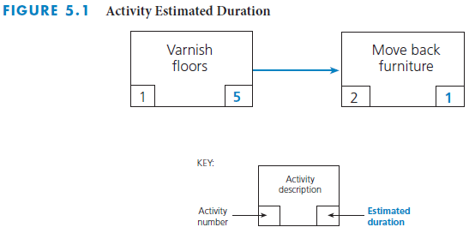
Estimate Activity Durations
Duration must be the total elapsed time
  Time for the work to be done plus any associated waiting time
Notes:
Estimate activity durations
Once the types and quantities of resources are estimated for each activity, estimates can be made for how long it will take to perform the activities.
The estimated duration for each activity must be the total elapsed time – the time for the work to be done plus any associated waiting time.
The figure above depicts the activity estimated duration for varnishing floors.

Slide 17
Estimate Activity Durations
It is a good practice to have the person who will be responsible for performing a specific activity estimate the duration for that activity.
Designate an experienced individual to estimate the durations for all the activities the organization is responsible in large projects
Historical data can be a guide for similar or future projects
Estimated duration should be aggressive yet realistic
At the beginning of the project, it may not be possible to estimate the durations for all activities with the same accuracy
The project team can progressively elaborate the estimated durations as more information is known or becomes clear
Notes:
It is a good practice to have the person who will be responsible for performing a specific activity estimate the duration for that activity.
Builds buy-in from the person and generates commitment
Avoids bias that may be introduced by having one person estimate the durations for all of the activities
It is important to designate an experienced individual to estimate the durations for all the activities for which the organisation or subcontractor is responsible in large projects.
Historical data can be used as a guide in estimating the durations of similar activities for future projects.
Estimated duration should be aggressive yet realistic.
Inflating estimated durations in anticipation of the project manager negotiating shorter durations is not a good practice.
Throughout the performance of the project, some activities will take longer than their estimated duration, others will take less time than estimated, and a very few may conform to the estimated duration exactly.
At the beginning of the project, it may not be possible to estimate the durations for all activities with a high level of confidence.
The project team can progressively elaborate the estimated durations as more information is becomes available to allow for more accurate estimated durations.

Slide 18
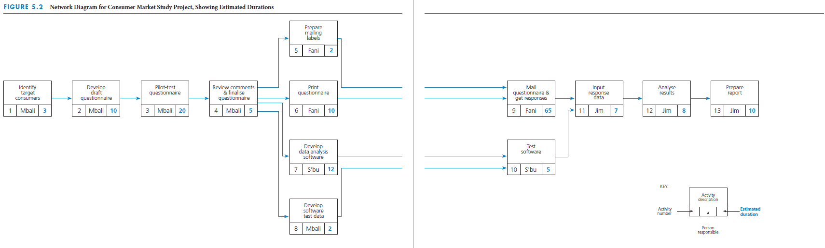
Estimate Activity Durations
Notes:
This figure depicts the network diagram for a consumer market study, with the estimated durations in days for each activity.
What are the realistic estimates for the activities shown?
What happens if an activity is delayed and will be its impact on the project?
What happens if an activity finishes early?

Slide 19
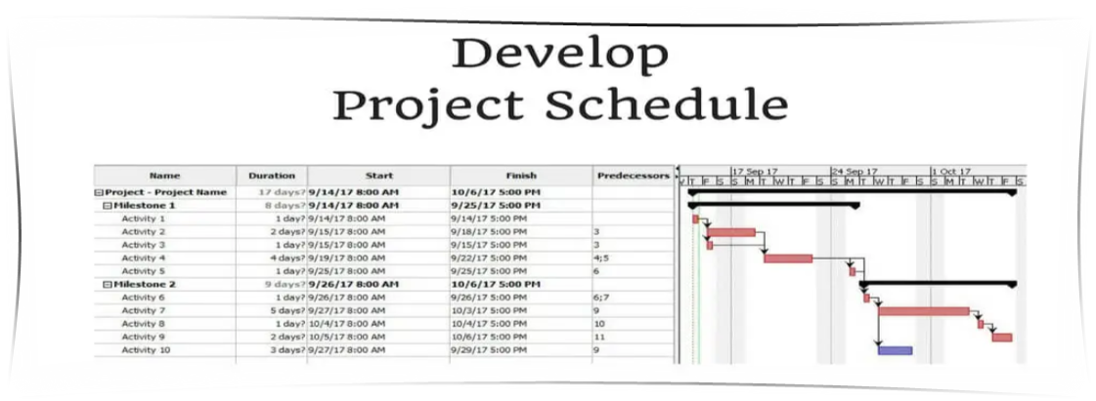
Develop Project Schedule
Prior activities for schedule development
  Estimate duration of each activity
  Establish overall window of time for the project
Develop the schedule timetable
  Earliest start and finish times based on estimated start date
  Latest start and finish times based on required completion date
Notes:
Develop project schedule
Once you have an estimated duration for each activity in the network must determine (based on durations and sequence) whether the project can be realistically finished by the required completion time.
In order to do this, the contractor should estimate the duration of each activity.
He or she should establish an overall window of time for the project.
Develop a project schedule that provides a timetable for each activity and shows:
The earliest times (or dates) at which each activity can start and finish, based on the project estimated start time (or date)
The latest times (or dates) by which each activity must start and finish in order to complete the project by its required completion time (or date)

Slide 20
A. Earliest start and finish times
Earliest start time (ES)
  Earliest time at which a specific activity can begin
Earliest finish time (EF)
  Earliest time by which a specific activity can be completed
EF = ES + Estimated duration
The ES and EF times are determined by calculating forward through the network diagram → beginning of the project to the end of the project
One rule that must be followed in making these forward calculations
Rule 1: The earliest start time for a specific activity must be the same as or later than the latest of all the earliest finish times of all the activities leading directly into that specific activity
Notes:
A. Earliest start and finish times
Earliest start time (ES) is the earliest time at which a specific activity can begin.
It is calculated on the basis of the project estimated start time and the estimated durations of preceding activities.
Earliest finish time (EF) is the earliest time by which a specific activity can be completed.
It is calculated by adding the activity’s estimated duration to the activity’s earliest start time.
EF = ES + Estimated duration
Calculate forward through the network diagram from the beginning of the project to the end of the project.

Slide 21
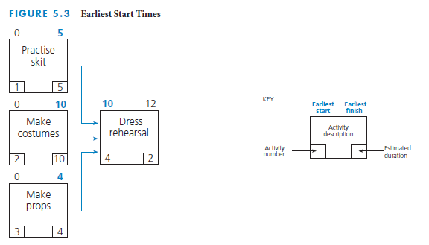
Earliest start and finish times calculation
Why is the ES for 'Dress rehearsal’ 10?
Notes:
Earliest start and finish times calculation
This figures depicts the three activities that go into the production of a 'Dress rehearsal' for a play. You will note that 'Practice skit' has an EF of day 5; 'Make costumes' has an EF of day 10; and 'Make props' has an EF of day 4.
'Dress rehearsal' cannot start until all three of these activities are finished, so the latest of the EFs for these three activities determines the ES for 'Dress rehearsal.'
The latest of the three EFs is day 10 – the earliest finish time for 'Make costumes’.
Therefore, 'Dress rehearsal' cannot start any earlier than day 10. That is, its ES must be day 10 or later.
Even though 'Practice skit' and 'Make props' may finish sooner than 'Make costumes’, 'Dress rehearsal' cannot start because the network dependent relationships indicate that all three activities must be finished before 'Dress rehearsal' can start.

Slide 22
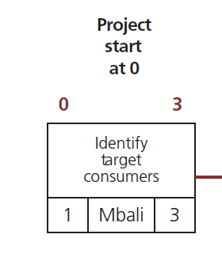
Figure 5.4 (page 157 – 158): Forward calculations for the consumer market study project
'Identify target consumers'
Start date = 0
ES = Start date = 0
Duration = 3
EF = 0 + 3 = 3
Notes:
'Identify target consumers'
In the following slides we will see the different activities and forward calculations that go into a consumer market study project.
The project estimated start date is 0 and the duration is three days.
Therefore, the earliest 'Identify target consumers' can start is time 0, and the earliest it can finish is 3 days later (because its estimated duration is 3 days).

Slide 23
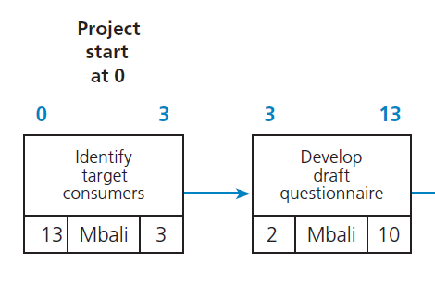
'Develop draft questionnaire'
ES = EF Task 1 = 3
Duration = 10
EF = 3 + 10 = 13
Notes:
'Develop draft questionnaire'
When 'Identify target consumers' is finished on day 3, 'Develop draft questionnaire' can start. It has an estimated duration of 10 days, so its ES is day 3 and its EF is day 13.

Slide 24
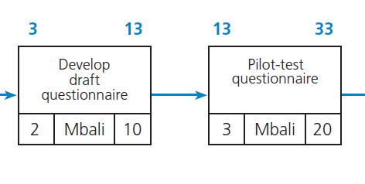
'Pilot-test questionnaire'
ES = EF Task 2 = 13
Duration = 20
EF = 13 + 20 = 33
Notes:
'Pilot-test questionnaire'
When 'Develop draft questionnaire' is finished on day 13, 'Pilot-test questionnaire' can start. It has an estimated duration of 20 days, so its ES is day 13 and its EF is day 33.

Slide 25
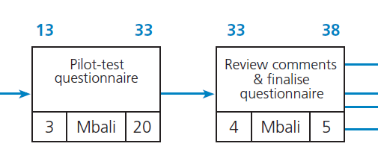
'Review comments & finalise questionnaire'
ES = EF Task 3 = 33
Duration = 5
EF = 33 + 5 = 38
Notes:
'Review comments & finalise questionnaire'
When 'Pilot-test questionnaire' is finished on day 33, 'Review comments & finalise questionnaire' can start. It has an estimated duration of 5 days, so its ES is day 33 and its EF is day 38.

Slide 26
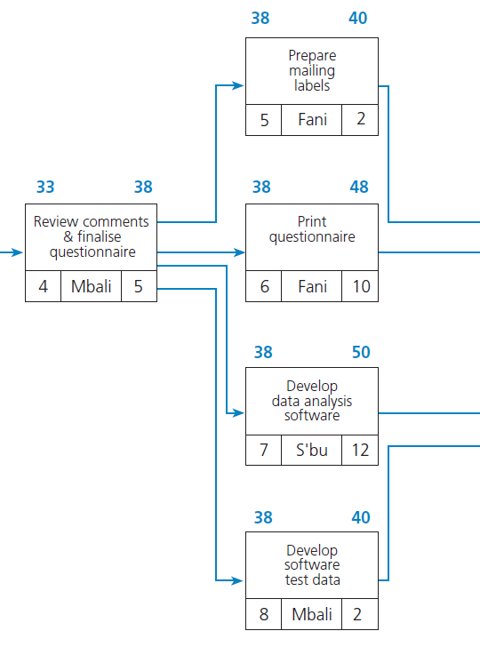
'Prepare mailing labels’, 'Print questionnaire’, 'Develop data analysis software’, and 'Develop software test data'
ES = EF Task 4 = 38
Task 5
  Duration = 2
  EF = 38 + 2 = 40
Task 6
  Duration = 10
  EF = 38 + 10 = 48
Task 7
  Duration = 12
  EF = 38 + 12 = 50
Task 8
  Duration = 2
  EF = 38 + 2 = 40
Notes:
'Prepare mailing labels’, 'Print questionnaire’, 'Develop data analysis software’, and 'Develop software test data'
When 'Review comments & finalise questionnaire' is finished on day 38, 'Prepare mailing labels’, 'Print questionnaire’, 'Develop data analysis software’, and 'Develop software test data' can all start.
The ES for each activity is 38, but they each have different EFs.
'Prepare mailing labels,' has an estimated duration of 2 days, so its EF is day 40.
'Develop data analysis software' has an estimated duration of 10 days, so its EF is day 48.
'Develop data analysis software' has an estimated duration of 12 days, so its EF is day 50.
'Develop software test data' has an estimated duration of 2 days, so its EF is day 40.

Slide 27
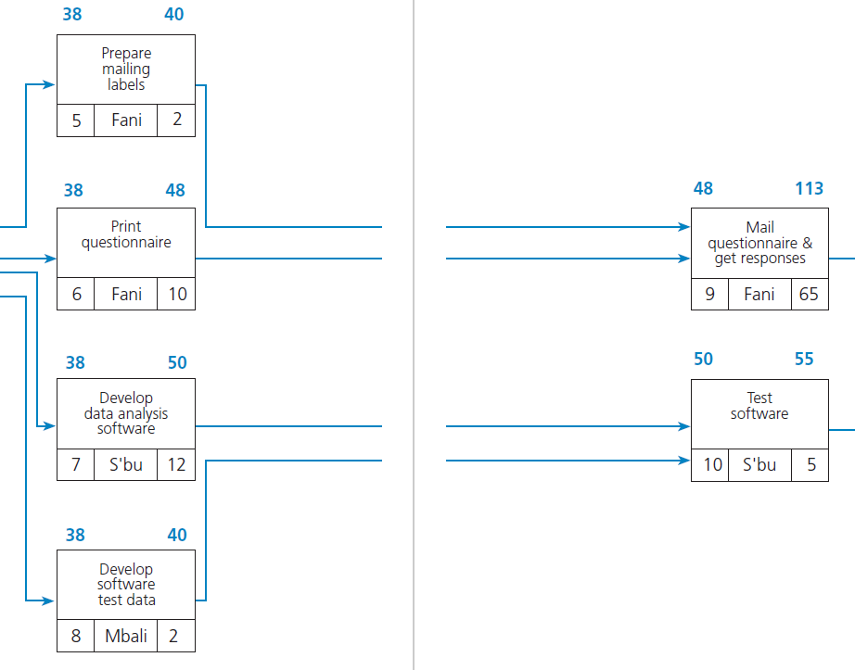
'Mail questionnaire & get responses'
Latest of Tasks 5 and 6 = 48
ES = EF Task 6 = 48
Duration = 65
EF = 48 + 65 = 113
Notes:
'Mail questionnaire & get responses'
When 'Prepare mailing labels' and 'Print questionnaire' are finished, 'Mail questionnaire & get responses' can start.
The later of the two EF times for 'Prepare mailing labels' and 'Print questionnaire' is 48, therefore this is the ES.
'Mail questionnaire & get responses' has an estimated duration of 65 days, so its ES is day 48 and its EF is day 113.

Slide 28
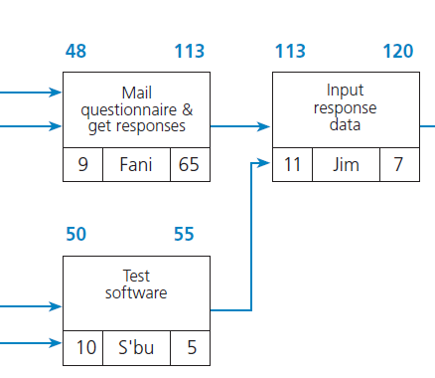
'Input response data'
Latest of Tasks 9 and 10 = 113
ES = EF Task 9 = 113
Duration = 7
EF = 113 + 7 = 120
Notes:
'Input response data'
When 'Mail questionnaire & get responses' and 'Test software' are finished, 'Input response data' can start.
The later of the two EF times for 'Mail questionnaire & get responses' and 'Test software' is 113.
'Input response data' has an estimated duration of 7 days, so its ES is day 113 and its EF is day 120.

Slide 29
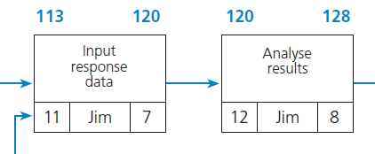
'Analyse results'
ES = EF Task 11 = 120
Duration = 8
EF = 120 + 8 = 128
Notes:
'Analyse results'
When 'Input response data' is finished on day 120, 'Analyse results' can start.
It has an estimated duration of 8 days, so its ES is day 120 and its EF is day 128.

Slide 30
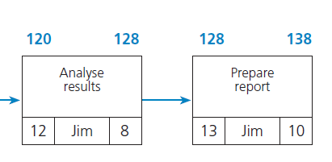
'Prepare report'
ES = EF Task 12 = 128
Duration = 10
EF = 128 + 10 = 138
Project not complete in required time
Notes:
'Prepare report'
When 'Analyse results' is finished on day 128, 'Prepare report' can start.
It has an estimated duration of 10 days, so its ES is day 128 and its EF is day 138.
The required completion time for this entire project is 130 days. 138 days is 8 days beyond the required completion time, therefore the project was not completed in the required time.

Slide 31
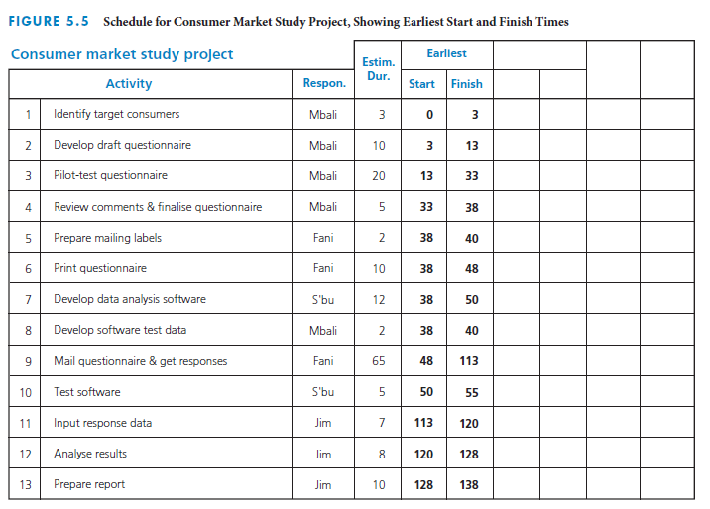
Schedule table ES and EF
Notes:
Schedule table ES and EF
This figure depicts the ES and EF times for the consumer market study project we just analysed, in a schedule table format.

Slide 32
B. Latest start and finish times
Latest start time (LS)
  Latest time by which a specific activity must be started
Latest finish time (LF)
  Latest time by which a specific activity must be completed
LS = LF – Estimated duration
The LF and LS times are determined by calculating backward through the network diagram from the end of the project to the beginning of the project
One rule that must be followed in making these backward calculations
Rule 2: The latest finish time for a specific activity must be the same as or earlier than the earliest of all the latest start times of all the activities that flow directly from that specific activity
Notes:
Latest start and finish times
Latest start time (LS) is the latest time by which a specific activity must be started in order for the entire project to be finished by its required completion time.
It is calculated by subtracting the activity’s estimated duration from the activity’s latest finish time.
Latest finish time (LF) is the latest time by which a specific activity must be completed in order for the entire project to be finished by its required completion time.
It is calculated on the basis of the project required completion time and the estimated durations of succeeding activities.
LS = LF – Estimated duration
Calculate backward through the network diagram from the end of the project to the beginning of the project.

Slide 33
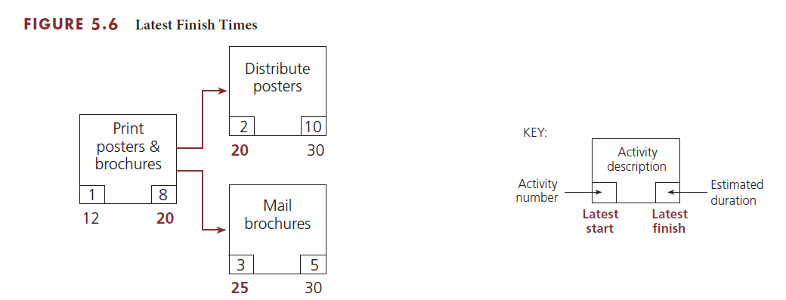
Figure 5.6 (page 159): Latest Finish Times
Latest start and finish times calculation
Why is the LF for 'Print posters & brochures' 20?
Notes:
Latest start and finish times calculation
These figures show two activities that emerge directly from an activity labelled, 'Print posters & brochures’.
This project is required to be completed by day 30. Therefore, 'Distribute posters' must be started by day 20 because it has an estimated duration of 10 days, and 'Mail brochures' must be started by day 25 because it has an estimated duration of 5 days.
The earlier of these two LSs is day 20. Therefore, the latest that 'Print posters & brochures' can finish is day 20, so that 'Distribute posters' can start by day 20.
Even though 'Mail brochures' does not have to start until day 25, 'Print posters & brochures' must finish by day 20, or else the entire project will be delayed.
If 'Print posters & brochures' does not finish until day 25, then 'Distribute brochures' will not be able to start until day 25.
Because 'Distribute brochures' has an estimated duration of 10 days, it will not finish until day 35, which is 5 days beyond the project required completion time.

Slide 34
1.6. LU6: Chapter 5
Critical path
Longest path in the overall network diagram
Find which activities have the least amount of slack
Notes:
Critical path
The critical path is this longest path in the overall network diagram.
One way to determine which activities make up the critical path is to find which ones have the least amount of slack.

Slide 35
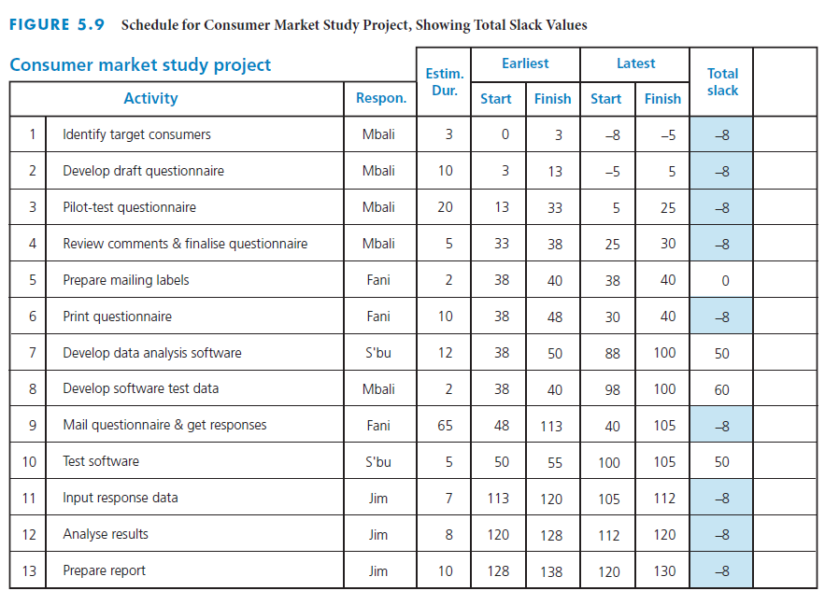
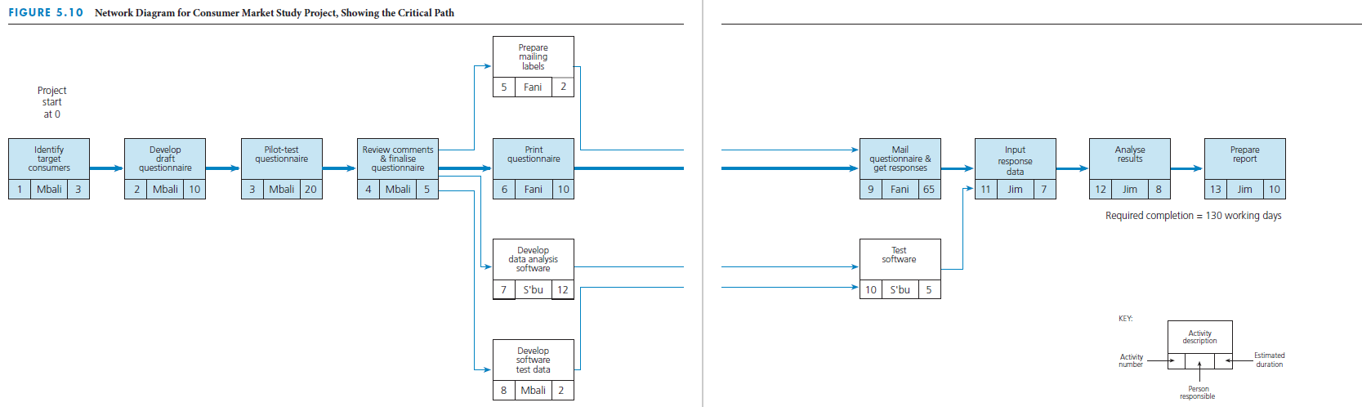
Critical path through a project
Notes:
Critical path through a project
This table shows slack values for each activity in the consumer market study project we just analysed.
Those with -8 as the total slack are the activities on the critical path.
The figure on the bottom of the slide depicts the critical path through the network diagram for the consumer market study project.

Slide 36
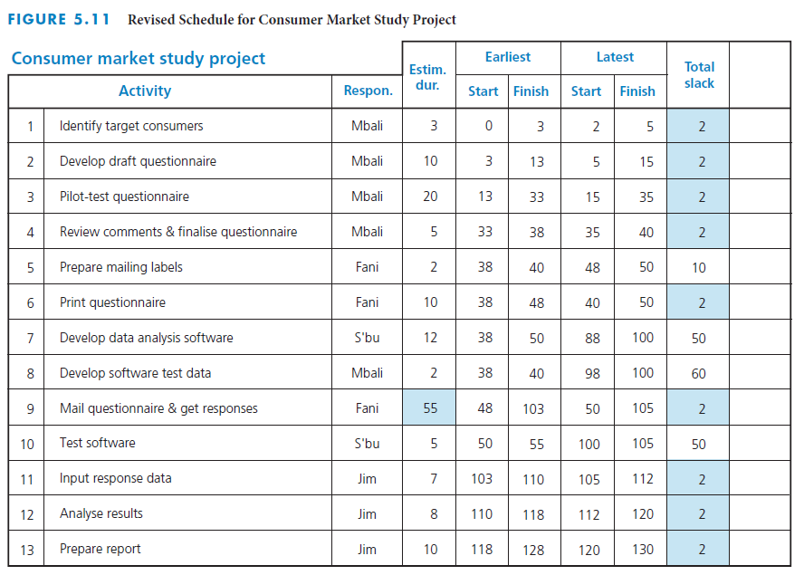
Change in slack for critical path
Notes:
Change in slack for critical path
This figure depicts the change in the critical path if the estimated duration of the ‘Mail questionnaire & get responses’ task is reduced from 65 days to 55 days.
Note that the tasks on the critical path now have a total slack of 2, the least amount slack in the project.

Slide 37
1.7. Explained in the Assignment 2 Breakdown Online Lecture

Slide 38
1.8. LU5: Chapter 4 to Chapter 6
Microsoft Project
Follow the steps in Chapter 4: Apendix Microsoft Project – page 141 to 147
Follow the steps in Chapter 5: Apendix 2 Microsoft Project – page 209 to 217
Notes:
Ensure you set a realistic budget for the project
Schedule for the project is 8 months – you can use days – must equate to 8 months

Slide 39
1.9. LU5: Chapter 4 to Chapter 6
Microsoft Project
Resource Usage Report
  Follow the steps in Chapter 6: Apendix Microsoft Project – page 240 to 247
Network Diagram
  Follow the steps in Chapter 4: Apendix Microsoft Project – page 145 to 147

